Slide 1
Analytics: A Cornerstone for
Performance Improvement at MedStar Health
February 21, 2020 – Healthcare Technology Network of Greater Washington
David Branch, VP, Performance Improvement
Matt D’Agostino, Sr. Performance Improvement Manager

Slide 2
Agenda
Performance Improvement Philosophy
Integrated Analytics and PI
Analytics Journey
Key Attributes of Development
Deployment and Engagement
Use Case – OR Expense Analytics
Future State

Slide 3
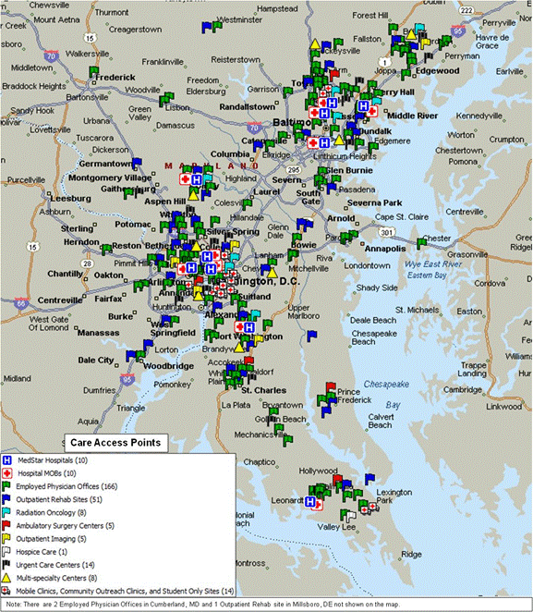
MedStar Health, Inc.
The largest healthcare provider in Maryland and the Washington, D.C., region
10 hospitals and over 300 sites in MedStar’s Distributed Care Delivery Network
Over 30,000 associates and 4,700 affiliated physicians
$5.6B in revenue, not-for-profit
Official healthcare partner of the Ravens, Orioles, and Capitals organizations

Slide 4
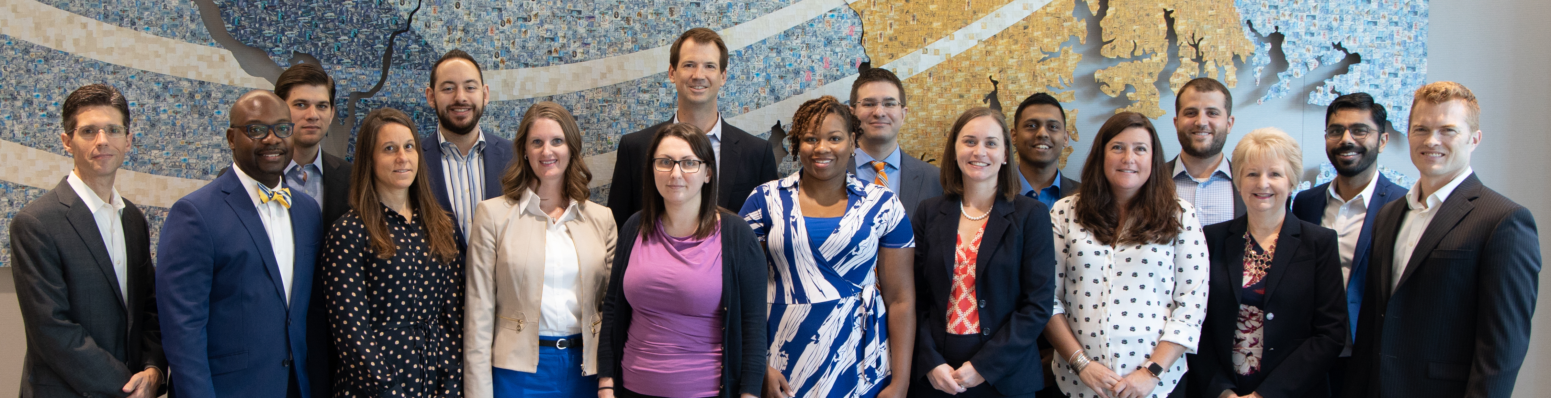
MedStar’s Performance Improvement Team
Established in 2016 as part of the MedStar Performance Transformation 2020 strategy; re-branded as Performance Improvement (PI) in 2017
21 full-time team members
Strong and varied mix of expertise in healthcare, systems engineering, project management, consulting, data analytics, Lean, and Six Sigma
Manage over 20 on-going programs and projects in clinical and operational environments

Slide 5
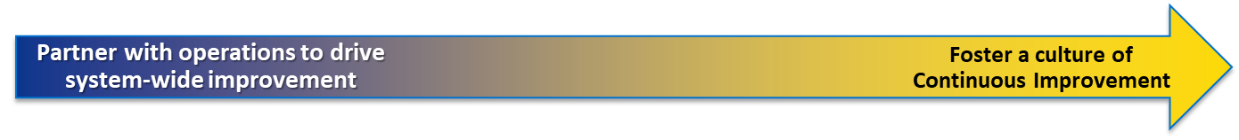
Performance Improvement Philosophy
Mission:
To advance High Reliability Organization (HRO) in MedStar through a culture of continuous improvement
Vision:
To be a market leader and high-performing Performance Improvement Team
Performance Improvement is a Process
Continuous Improvement is a Culture
A business methodology to measure current performance outcomes and develop or modify existing processes to increase the efficiency and effectiveness of said processes and business functions
A business mindset and set of behaviors that seek to indefinitely improve a business and deliver product/service excellence of an organization through transactional and transformational change
Capability
(Tools & Methodology)

Slide 6




Integrated Analytics & Performance Improvement
Support and nurture a culture of data-based decision making across MedStar
  Enabler of a high-reliability organization
Provide analytical guidance and thought partnership for driving performance improvement
Shed light on data insights, patterns, and root causes of problems
Build self-serve analytical decision-support products to support continuous improvement
Performance Dashboards
Decision Support Tools
Statistical Analytics
Predictive Analytics

Slide 7
Performance Improvement Analytics Journey
Level 1 Fragmented | Level 2 Enterprise Perspective | Level 3 Advanced Analytics | Level 4 Intelligent Process Automation
Local reporting No governance Basic descriptive data Low data literacy | Collective strategy with standardized enterprise KPIs Situation awareness and visibility to results on a system-level, entity level, and local level Self-service drill-down and trending Goals aligned with organizational strategy | Advanced algorithms and statistics enable enriched data for transformational insights and process optimization Broad data literacy established in end users Data-driven simulations support decision-making | Business and clinical decision algorithms Resource and expense optimization Used in real-time operational situations
Adapted from: Kuhnen, G. (2017). Business intelligence maturity model. Advisory Board. Advisory.com.

Slide 8
Performance Improvement Analytics – Current State
Technology Enablers
Level 1 Fragmented | Level 2 Enterprise Perspective | Level 3 Advanced Analytics | Level 4 Intelligent Process Automation
Dashboard | Provides visibility to…
Periop Volumes | Volume trends by specialty across the system and by entity
OR Cancellations | Drill-down into cancellations by reason and by provider
IMOC Patient Experience | Performance of pt exp metrics targeted by the IMOC initiative
IMOC Patient Throughout | Risk-adjusted expected LOS and unfavorable opportunity days
Sepsis Process Dashboard & Balanced Scorecard | Process metrics and outcome metrics for catalyzing improvement in the care of sepsis patients
PAT | Timely execution of the PAT process
Imaging Services | Volume trends, utilization of imaging technology, radiology safety, productivity and operational efficiency
Demand Management | Projects in flight and in queue, project cycle times, current project statuses
Denials | Management of technical and clinical denials by cost by entity
Anesthesia | Patient quality, pain management, medication usage, and care efficiency
Dashboard | Provides visibility to…
OR Labor Productivity Tool | Productivity measures and guidance for end user in modeling OR labor schedules to optimally meet demand of actual OR room usage by time of day
OR Supply Expense Explorer Tool | Guides end user drill-down to discover root causes of expense variances by Cost Center, by GL Account, and more, when accounting for factors such as volumes vs. budget
Tableau visualization software
Health Catalyst
Enterprise Data Warehouse
(integrates EMR, billing, ERP/finance, clinical benchmarking data, and more)
SQL Server;
Upgraded CPU & RAM on laptops

Slide 9
Development Process
Planning Stage
Legend
Data Sourcing &
Core Development
1. Project Planning
Identify scope
Draft charter
2. Requirements Gathering
Stakeholder Interviews
Define success
3. Metrics Alignment
Metrics Ideation
Sketch wireframe mock-up
Late-Stage Development
& Roll-Out
6. Test & Validation
Formal Test & Evaluation Review with sponsor and stakeholders
5. Prototyping
Build prototype
Validate with SME
4. Data Sourcing
Data flow diagram
Data specs
Iteration
Iteration
7. Design Refinement
Improve design for user-friendly interface and flow
8. Pilot User Testing
Pressure test it
9. Go-Live and
User Training
User manual
Training sessions
10. Maintenance & Troubleshooting
v2.0 iterations
Formal hand-off to process owner
Operations-owned sustainability & governance

Slide 10
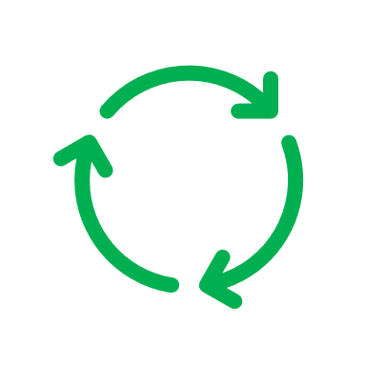
Deployment Process and Engagement Strategies
Tableau Dashboards
Dashboard Rollout
User Engagement
Beta Version
Final Version
Revised
Application
Beta Application
Published
Final Application
Published
Incorporating prioritized enhancements
Direct User
Interactions
Webex Feedback
Session with pilot users
Webex Demo
Sessions
Share best practices
and use cases via:
Integrate feedback in dashboard | Share best practices with others
Training and coaching on dashboard & to drive better decision-making | Training and coaching to drive better decision-making
HIGH
Focused Webex meetings
Periodic New User Training
Email Feedback
Performance
Office Hours
LOW
Train the Trainers
LOW
HIGH
Dashboard Utilization
Indirect Interactions
Recorded Demo available for viewing
Data Dictionary &
User Guides

Slide 11
OR Supply Expense Explorer
Problem:
OR operations managers rely on multiple systems and manual processes to access, comprehend, and analyze their budget variances and expense trends, accounting for volume and case complexity
The current analytical workflow is time consuming, complex, and limited
Goals: Develop a user-friendly application that will…
Provide insight into financial condition and causes of variance within OR supply chain
Facilitate end-user exploration and drill-down of data; eliminate ad-hoc analysis
Act as a catalyst for cost reduction initiatives, and performance improvement
Inform budgeting forecasting process for future fiscal years
Spark improvement in cost capture into the correct GL Accounts (reduced reliance on misc. spend categories)

Slide 12
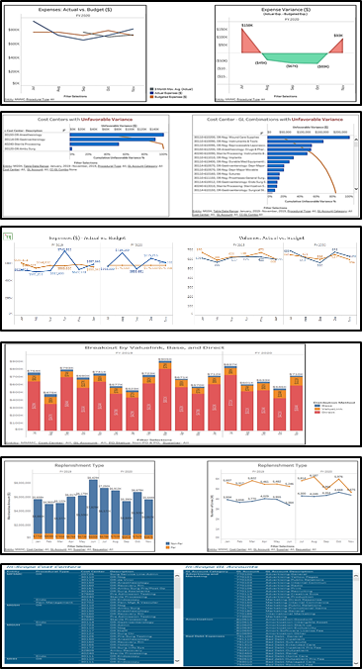
OR Supply Expense Explorer
Level A: Non-Labor Operating Expenses
Level B: Performance of GL Categories
Level C: Expense to Volume
Level D: Accounts Payable (AP)
Level E: Purchase Order (PO)
Reference Tables / Data Dictionary

Slide 13
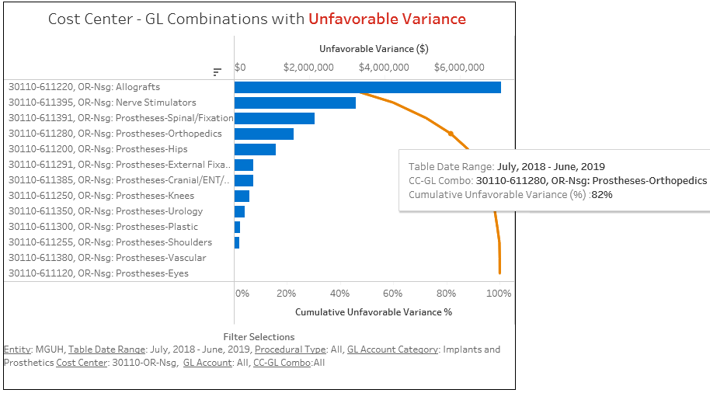
Identify Top Cost Center & General Ledger Account Overspend
  Top 4 GL Accounts contribute to >80% of unfavorable variance

Slide 14
Analyze AP Trends by Supplier
  AP spend by top suppliers to identify better contracting opportunity.
  May be sorted by volume of orders
  AP line items table also provides PO #, Invoice ID and Supplier ID for drill-down

Slide 15
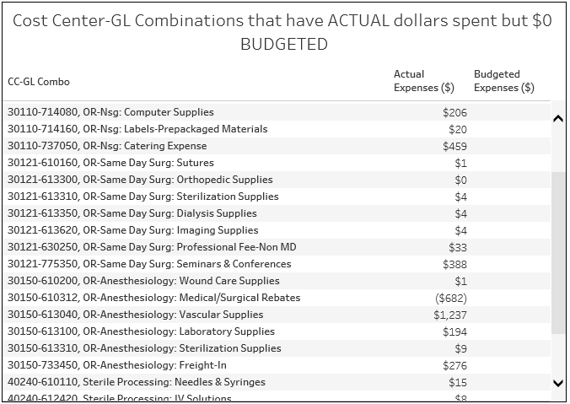
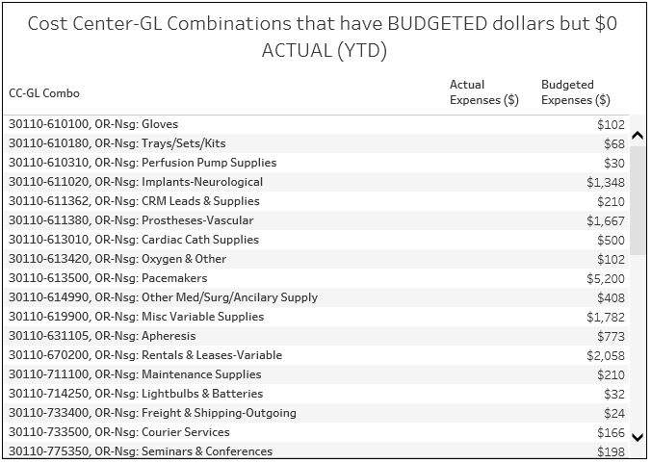
Improved Budget Forecasting
What supplies are not budgeted accurately?
  Unbudgeted expenses and unused budget are listed out at CC-GL Combo level

Slide 16
Future State
System-wide labor productivity and workforce management analytics
Exploratory analyses to identify opportunity areas of clinical variation
Upskill our analysts to perform Data Scientist functions
Predictive analytics & machine learning
  Likelihood of sepsis onset
  Likelihood of no-show appointments
  Volume forecasting to optimize staffing levels

Slide 17

Thank you!
To learn more about PI at MedStar, visit our website at pi.medstarhealth.org
  Train on MedStar’s PDCA methodology
  Learn more about our team and job opportunities
  View case studies and videos about MedStar’s process improvement success stories
Contact us at performanceimprovement@medstar.net

Slide 18

Appendix

Slide 19
Development Process
Metrics Glossary
Dashboard wireframe mock-up
Charter
Legend
Planning Stages (Steps 1-3)
1. Project Planning
Executive kick-off
Identify scope
Define intended audiences
Draft charter
Identify stakeholders & SME's
Share anticipated risks
Initial vision for long-term sustainability and ownership
2. Requirements Gathering
Stakeholder Interviews, Meeting, and/or Survey
Define success
Discuss info needed to make business decisions
Collect samples of existing dashboards and metrics currently tracked
3. Metrics Alignment
Metrics Ideation
Prioritization of metrics
Establish standard definitions
Define exclusion criteria
Determine scope of financial data
Initial sketch wireframe mock-up of dashboard (consider audience levels)
Major Deliverable
Data Sourcing &
Core Development
Stages (Steps 4-6)
Late-Stage Development
& Roll-Out (Steps 7-10)
Formal technical T&E review
6. Test and Validation
Technical Test & Evaluation Review: Formally present prototype to project team and key stakeholders for thorough testing and validation of metrics and formulas
Solicit additional user needs related to visualizations and drill-down options
5. Prototyping
Build prototype in Tableau with source data and formulas for computing each metric
Initial consideration of visualization and user interaction options, per mock-up
Validate each metric’s outputs with an SME
4. Data Sourcing
Solicit advisory support with IS/Decision Support
Obtain data from source of truth
Automate feeds if possible
Initial testing of joins, blends, aggregation, etc.
Escalate risks & data integrity gaps
Identify existing reports to be retired/deprecated
Data Flow Diagram
Data specs
Sustainability plan
Iteration
Iteration
7. Design Refinement
Complete the Tableau build, incorporating feedback
Improve design for user-friendly interface and flow
Ensure aesthetic design matches MedStar standards
8. Pilot User Testing
SMEs to pilot use of the dashboard
Pressure test it (try to “break it” and find defects)
Iterate and incorporate additional feedback into the design
Establish security permissions for Tableau Server for end users
9. Go-Live and
User Training
Official publication of dashboard
Communicate to all stakeholders
Finalize user manual with metrics glossary and description of dashboard functionality
Conduct user training
10. Maintenance & Troubleshooting
Address user questions
Resolve system bugs
Build enhancements as requested
Establish plan for formal hand-off to discipline, including data governance and dashboard
sustainability
Operations-owned sustainability & governance
Near-finalized analytical product
User manual
Training sessions

